Slide 1
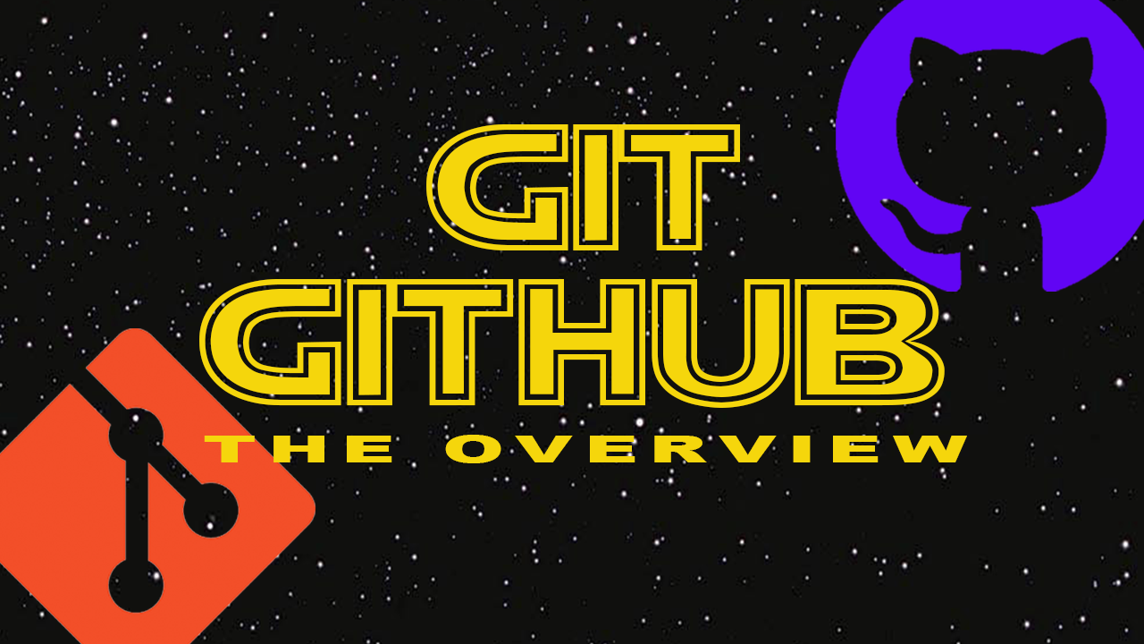

Slide 2
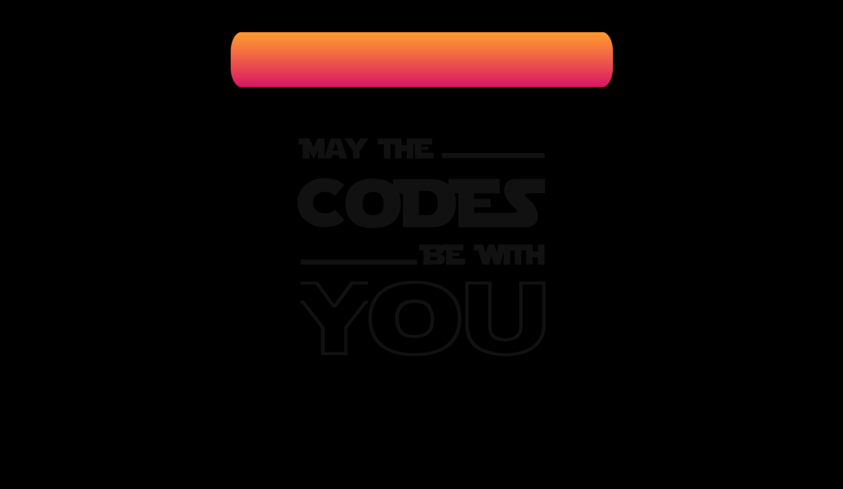

What is git?
Git is a free and open source distributed version control system designed to handle everything from small to very large projects with speed and efficiency. Also git a distributed version control system.

Slide 3
What is a version control system?
A version control system is basically a system that records changes made to a file or a set of files over period of time.
A version control system helps you to recall your specific versions whenever you needed.
For example: if you are an developer you want to keep every version of your deployment i.e. if you wanted to change something from your previous version, a VCS will help you to do so.

Slide 4
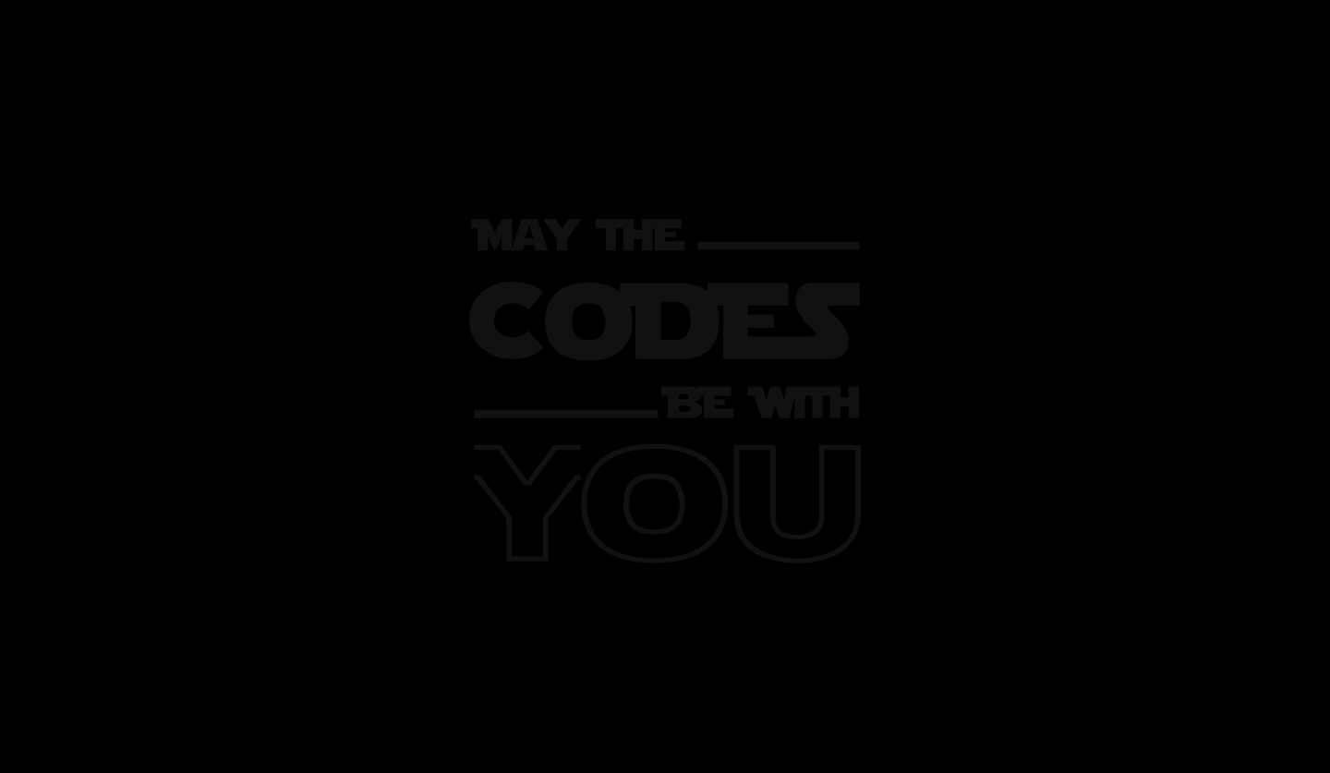
Initial Version
Created file
Version 1
Updated file
Version 3
Created another file
Version 2
Updated All Files
Version 4

Slide 5
Shared repository
Person 1
Person 2
Person 3

Slide 6
Git & Version Control
Working
Directory
Staging
Area
Git
Repository
Stage Files
Commit
Project Checkout

Slide 7
Why use git
Long term change history of your files.
Branching and Merging
Traceability
Integrity
Distributed Development
Safe Storage

Slide 8
Installing git
For Linux
If you are using a RPM – based distribution then run
$ sudo dnf install git-all
If you are using a Debian – based distribution then run
$ sudo apt install git-all
2. For MAC
There are several ways to install Git on a Mac. The easiest is probably to install the Xcode Command Line Tools. If you don’t have XCode just run
$ git –version
If it is not already existing it will lead you to the installation
3. For Windows
Just go the link in description and download it from there

Slide 9

Intro. to Github
It is the online platform that with git hosts your project.
You can share your projects with other developers.
Many developers can work together on the project.
Easy to merge their edits
It helps you to contribute to other developers projects

